Slide 1
Medicine Time
- Organize Your madecine's Intake!
Course Instructor :
Dr. Md. Hanif Seddiqui Professor Department of CSE University of Chittagong
Submitted by
ID Name
17701088– - Sadia Sharmin
17701103 - –Maharun Nessa Meem

Slide 2
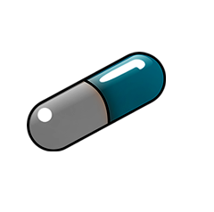
01 INTRODUCTION
02 PROBLEM DEFINITION
03 PROBLEM SOLUTIONS
04 Features You Can Enjoy
05 Benefits Of Using This App
06 DFD-0
07 Entity Relationship Diagram
08 Activity Diagram
09 Tools/Tech we have used
10 Testing
07 Snapshots of Our App
08 Limitation of Our Application
09 Future Work
06 CONCLUSION
CONTENTS

Slide 3
Introduction
• Majority of patients forget to take medicine as it is prescribed.
• Also forgets which medicine He/ She have to take at required time.
• To overcome this, we have tried to design the MEDICINE TIME.
.

Slide 4
PROBLEM DEFINITION
Medicine adherence is a very serious problem because it may affect the total well-being of the patient, delaying the curing time and also raising the total medical cost of the patient.
People of different ages still forget to take their prescribed medicines or pills in due time and proportion .
Reasons for forgetting are -busy schedules,old age, cognitive disorders, bad working conditions, Alzheimer disease, loss of memory, dementia, people with emotional problems, stress, anxiety, depression etc.

Slide 5
PROBLEM SOLUTIONS
Medicine Time App is an amazing application that can help to manage intakes of medicines and supplements on a regular basis.
Medicine-Time provides a one-month history through which the doctor or anyone can check at any time whether the patient has taken the medicine at the right time.

Slide 6
Features You Can Enjoy:
You can create a medicine schedule
Can make a reminder list
Reminds you to take medicine at the right time
Soothing notification sound
Show a history of reminders of 1 month
You can see the existing reminder list
You can keep and delete medicine from list.
Simple Configuration
Completely free

Slide 7
Benefits Of Using This App:
1. Help to maintain a record of medicine intake
2. Reduce stress of remembering the taking of medicines on time
3. Doctor or other family member can check at any time whether the patient has taken the medicine at the right time within one month .

Slide 8
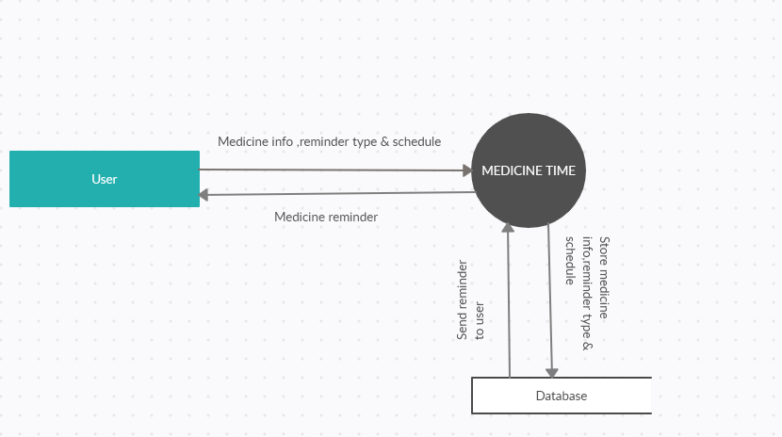
DFD-0:

Slide 9
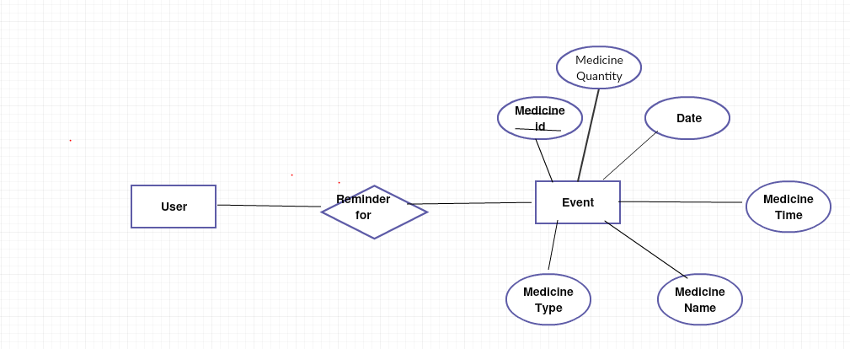
Entity Relationship Diagram:

Slide 10
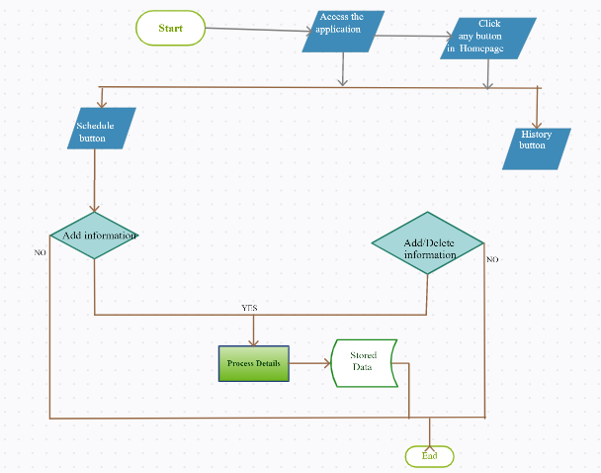
Activity Diagram

Slide 11
Tools/Tech we have used:
i)Android Studio
ii) SQlite

Slide 12
Testing
Ad hoc Testing
Unit testing
Integration testing
Beta testing

Slide 13
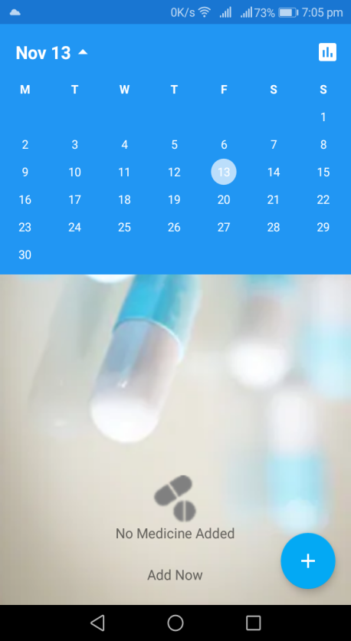
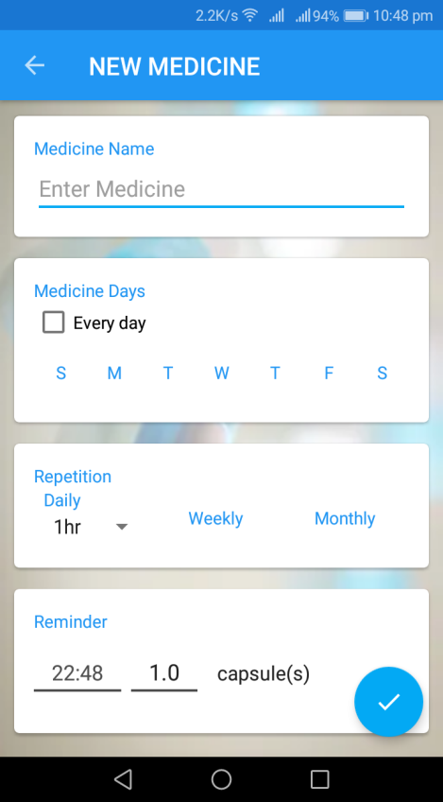
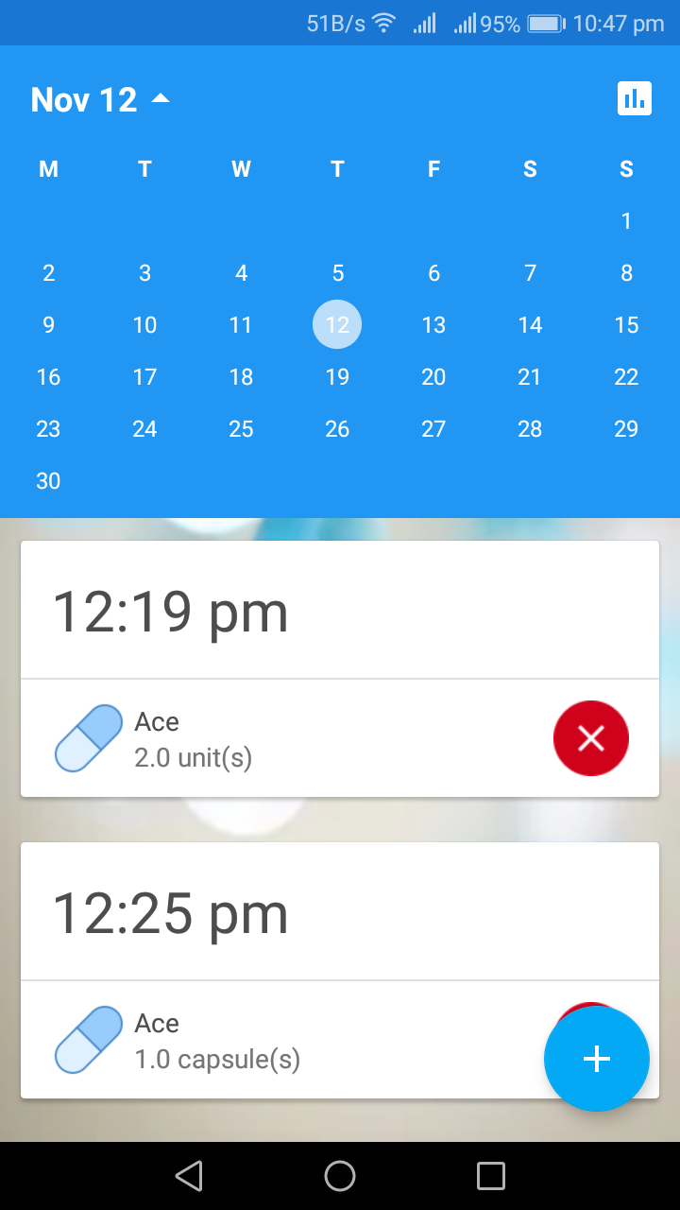
Snapshots of Our App:

Slide 14
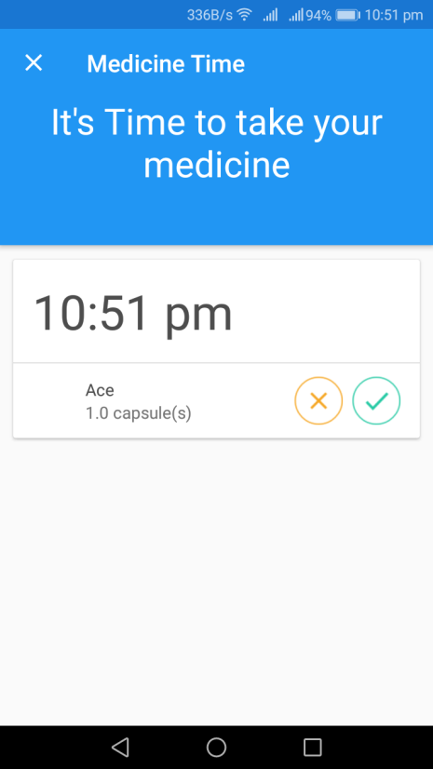
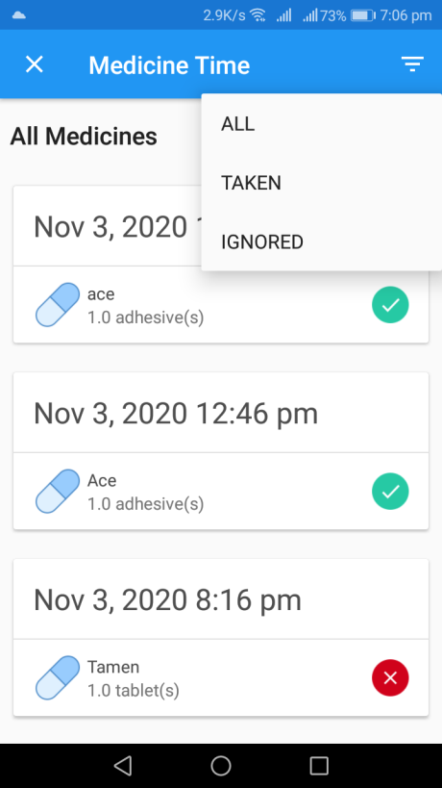
Snapshots of Our App:

Slide 15
Limitation of Our Application:
Has no cloud based backup system in case the smart phone in which the application was installed got missing or faulty the whole data would be lost.
Makes uses of the smart phone alarming system to notify the patient to take their medicine, if the patient changes the phone mode to silent the patient cannot hear the alarm to remind him/her to take their medicine in the prescribed appropriate time
Some essential services are missing

Slide 16
Future Work:
1.A comment section in which users can comment after taking medicine.
2.Sleep time(a period where alarm don't ring, only show notification).
3.Track health measurments for various medical condition .
4. Track tablets,dose,measurment,activities as a comprehensive health journal.
5. Sharing printable health journal with doctor.
6.The status of madicine packet can also be known.
.

Slide 17
CONCLUSION
• The medicine reminder will be very helpful to many patients
• It helps to take proper medicine at right time
• No cost at all.

Slide 18
THANK YOU

